Slide 1
Testing Techniques (Exercises)
7th Lecture
Madiha Malik

Slide 2
Basic Test Design Techniques
Specification-based test design techniques (Black-box test design techniques)
Procedure to derive and/or select test cases based on an analysis of the specification, either functional or non-functional, of a component or system without reference to its internal structure.
Structure-based test design techniques (White-box test design techniques)
Testing based on an analysis of the internal structure of the component or system
Defect-based test design techniques
A procedure to derive and/or select test cases targeted at one or more defect types, with tests being developed from what is known about the specific defect type
Experience-based test design techniques
Procedure to derive and/or select test cases based on the tester's experience, knowledge and intuition

Slide 3
Specification-Based Test Design
Test cases designed based on specification document
Specification defines the expected behavior of the software/system
Specification can be of any form, e.g
Software requirement specifications
System requirement specifications
Feature list
Models
Diagrams
There can be a multiple set of specification documents – all combined together are called Test Basis

Slide 4
Specification-Based Test Design (Cont’d…)
Different design techniques exist to cover different aspects of test coverage
Each has their own strengths, weaknesses and minimum test coverage criteria
Specification Test Coverage
Defined by the percentage of specification items addressed by designed tests
Coverage of all specification does not mean complete system test coverage
Means identified specifications has been addressed
Minimum Coverage
Indicates when you have achieved test coverage with at least on test designed for each condition or data set
It should not be the end goal but it can be used as indicator

Slide 5
Equivalence (Class) Partitioning
Grouping test conditions into partitions that will be handled the same way
Every value or condition in a partition is treated equivalently
If testing one value from a partition does not result in error then it is less likely to fail for all other values in respective partition
Used for achieving data handling related test coverage and identifying associated bugs

Slide 6
ECP Examples
Partitions for a system that takes 1-100 integer values
x<1 (Invalid Partition) | 1<=x<=100 (Valid Partition) | x>100 (Invalid Partition)

Slide 7
Test Coverage
Coverage in Equivalence partition is determined
Number of tested partitions divided by total partitions
In example of 1-100 integer value
Data set = {25} -> Coverage = 1/3 = 33.33%
Data set = {3, 25, 97} -> Coverage = 1/3 = 33.33%
Data set = {-10, 25, 110} -> Coverage = 3/3 =100%
Minimum coverage criteria
One value from each partition

Slide 8
Types of Partitions
Different types of partitions possible
Type of possible characters (alphabetic, numeric, special characters)
Data type (integer, float, string, Boolean)
Character/digit size
Partition based on discrete set (value in the set or out of the set)
Valid values = {Lahore, Karachi, Islamabad}
Invalid values = every other string / city name
Partition based on file type or file size
Partition based on input interface (GUI, API, file, etc)
Partition based on output sets
There are 1-60 questions that need to answered (1 valid set)
80 % of required to pass the exam (now two valid sets – one for pass and one for fail) o Partitions based on past records, usage history or practical conditions, e.g.
most of the users make online orders of 2 to 10 items
Typical min and max temperature is different in month of December than in July

Slide 9
Example 1
Registration for an event opens for a limited time period (1st Jan to 30th Jan)
What if 1st to 10th 15% discount, 11th to 20th 5% discount, and 21st to 30th full price
<1st Jan (Early) | 1st-30th (Valid) | 30th Jan> (Late)
1st-10th (15%) (Valid) | 11th-20th (5%) (Valid) | 21st-30th (0%) (Valid)

Slide 10
Example 2
On selection of province, the application displays respective cities in another
Are These Enough?
Any String that is not a name of province (Invalid) | {Punjab, Sindh, Balochistan, KPK A.Kashmir} (Valid)

Slide 11
Example 2
Would need to test all the values because the output functionality changes (The City drop down has different states for each value)
Punjab | Lahore, Multan, etc
Balochistan | Quetta, Gwadar, etc
Sindh | Karachi, Hyderabad, etc
KPK | Peshawar, Swatt, etc
Azad Kashmir | Muzaffarabad, Mirpur, etc.

Slide 12
Example 3
A program displaying name of the day for an input fields of Day, month and year (for 2000 - 2020)
Input partitions:
Valid
Month = {30 Days month, 31 Days month, February}
Day={1-28, 29, 30, 31}
Year={Leap year, Non leap year}
In-Valid
Month = {<1, >12}
Day = {<1, >31}
Year = {<2000, >2020}
Output partitions
Valid
Day = {Monday, Tuesday, Wednesday, Thursday, Friday, Saturday, Sunday}
Invalid
Day = {Invalid date, Date out of range}

Slide 13
Boundary Value Analysis
Defining and testing for the boundary values of a partition
Identifies defects related to:
Displacement of boundaries
Omission of boundaries
Occasional extra boundary
Require identification of partitions similar to equivalence partitions and create test cases for boundary values of each partition

Slide 14
BVA Example
For the example of system that takes input of 1-100 integers
Invalid | Valid | Invalid
0 | 1 2 99 100 | 101

Slide 15
Boundary Value Analysis (cont.)
Boundary value analysis requires following analysis
ON conditions (1 & 100)
OFF conditions (0 & 101)
IN conditions (2 & 99)
School of thoughts
Two value boundary condition – test only ON and OFF conditions
Three value boundary condition – test IN, ON and OFF conditions
Boundary value analysis works only for ordered partitions because we are looking at the edges
Checking boundaries is important because:
Its common for developers to type <100 instead of <=100 : Displacement

Slide 16
Test Coverage
Coverage in boundary value analysis is determined
Number of tested distinct boundary values divided by that of total boundary values
In example of 1-100 integer values
Data set = {0,1,2} -> Coverage = 1/2 = 50%
Data set = {99,100,101} -> Coverage = 1/2 = 50%
Data set = {0,1,2,99,100,101} -> Coverage = 2/2 = 100%
Minimum coverage criteria
Test cases with Two/Three values for each boundary value

Slide 17
Possible Boundary Values
Possible boundary values
Edge values based on valid/invalid ordered / continuous set
First and last elements in an array/list even if the input is distinct set
Edges values in a sorted list
Edge values of allowed character/digit length
Testing for values of 49,50,51 characters for a field that allows maximum of 3 characters
Edge of allowed list size
Empty list, 1 element list, maximum allowed list, 1 more than maximum allowed list
Checking boundary values based on data structure size

Slide 18
Example 1
Registration for an event opens for a limited time period (1st Jan to 30th Jan)
Boundaries:
1st Jan & 30th Jan
Test Points:
{31st Dec, 1st Jan, 2nd Jan, 29th Jan, 30th Jan, 31st Jan}
<1st Jan (Early) | 1st-30th (Valid) | 30th Jan> (Late)

Slide 19
Example 1
Registration for an event opens for a limited time period (1st Jan to 30th Jan)
What if 1st to 10th 15% discount, 11th to 20th 5% discount, and 21st to 30th full price
<1st Jan (Early) | 1st-30th (Valid) | 30th Jan> (Late)
1st-10th (15%) (Valid) | 11th-20th (5%) (Valid) | 21st-30th (0%) (Valid)

Slide 20
Example 1
What if 1st to 10th 15% discount, 11th to 20th 5% discount, and 21st to 30th full price
Boundaries:
1st Jan, 10th Jan, 11th Jan, 20th Jan, 21st Jan & 30th Jan
Test Points:
{31st Dec, 1st Jan, 2nd Jan, 9th Jan, 10th Jan, 11th Jan, 12th Jan, 19th Jan, 20th Jan, 21st Jan, 22nd Jan, 29th Jan, 30th Jan, 31st Jan}
1st-10th (15%) (Valid) | 11th-20th (5%) (Valid) | 21st-30th (0%) (Valid)

Slide 21
Example 2
Price variation for unit purchase to bulk order
Number of units bought | Price per unit
First 10 units | $5.00
Next 10 units | $4.74
Next 10 units | $4.50
More than thirty units | $4.00

Slide 22
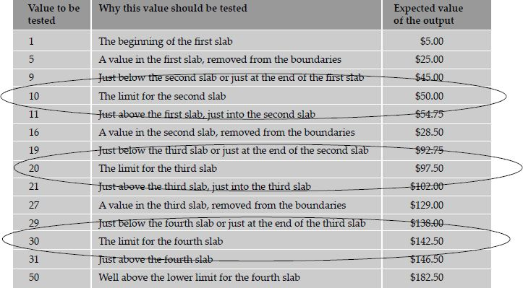
Example 2

